Slide 1
Intro to AI in Medicine
Lec 4: Training

Slide 2
Last Time
Learned about loss functions, finishing neural net structure
Defined regression, classification (including multiclass)
Associated final activation with loss function and problem type
Discussed some metrics for measuring how good our networks are

Slide 3


Python Gang

Slide 4
Agenda
Overfitting v underfitting
Internal/external validity
Hyperparameters
Revisit GD
Ensembling
Case study – afib ablations w/wo AI tool RCT

Slide 5
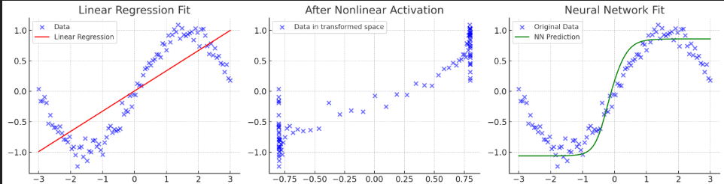
So Far…
We’ve seen plots like below, and assumed a good fit
How can we leverage metrics to tell us if we’re really fitting the trend?
How do we know if our model will work on other populations?
Notes:
We just used our eyes.

Slide 6
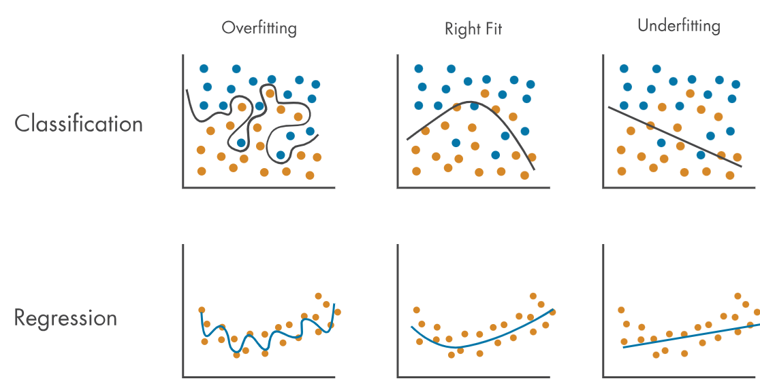
Fitting Data
Notes:
Audience participation
Hold for next slide

Slide 7
Fitting Data

Slide 8
Fitting Data
Notes:
Overfitting: Memorizing the data rather than learning a meaningful relationship
The issue is that this data does not generalize well
Our model knows these cases too well – it’s memorizing what data points go in what class.

Slide 9
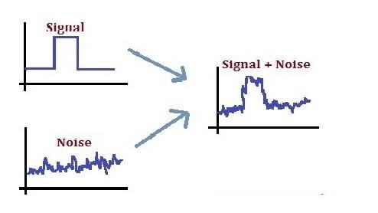
Overfitting
Overfitting: model is so closely aligned to the training data that it does not know how to respond to new data.
Overfitting can happen because:
  model is too complex; it memorizes very subtle patterns in the training data that don’t generalize well.
  The training data size is too small for the model complexity and/or contains large amounts of irrelevant information.
Notes:
Case 2: there’s not enough data to distinguish signal from noise
There will be random fluctuations in the data – we don’t want to be focusing on those more than the information we can reliably measure

Slide 10
Underfitting
The model couldn’t see the trend
Model is too simple to capture the underlying patterns and complexities of the data
Notes:
In overfitting, we think noise is signal
In underfitting, we don’t even know what signal is.

Slide 11
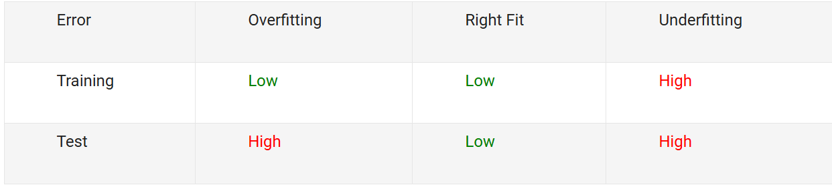
Did We Overfit?
(loss)

Slide 12
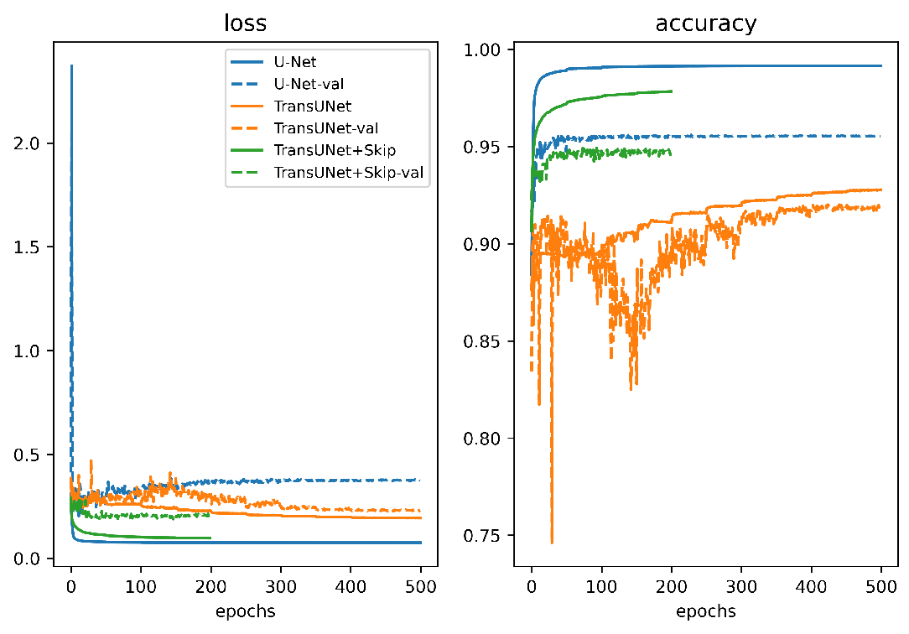
Training vs Test Loss and Accuracy
1 Epoch:
1 pass over all training samples

Slide 13
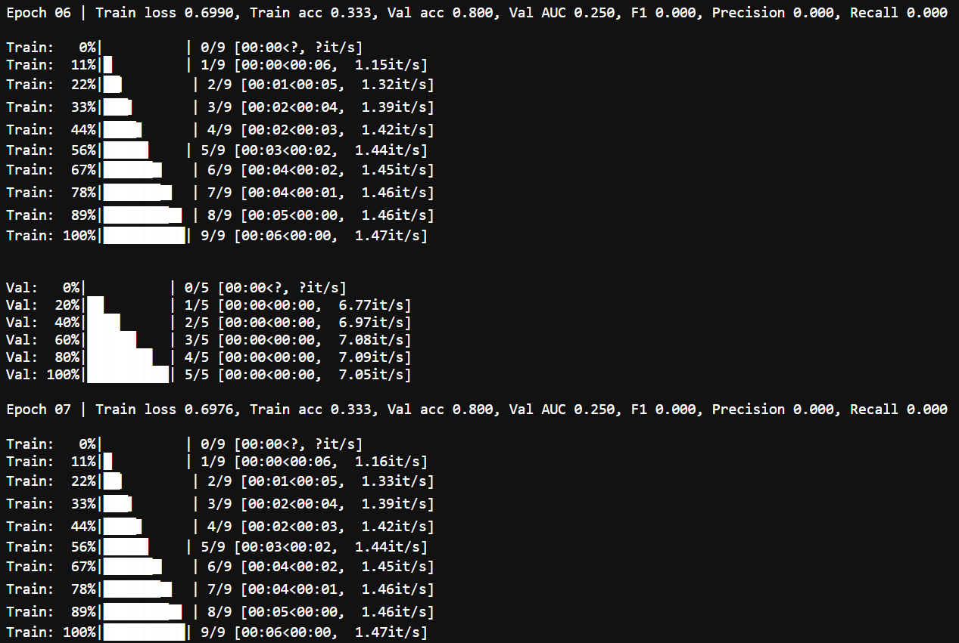
Training in Real Time

Slide 14
Intuition For Fit
Small models vs large models -> which would be more likely to overfit or underfit?

Slide 15
Checking External Validity
Divide data into parts
Train data: Data we actually use to check loss and update weights
Test data: Data we then use to compute accuracy to see if our model works on new data

Slide 16
Internal v External Validity
Internal validity: Is the model a good reflection of the data?
External validity: Can the model be used on other data?

Slide 17
Train/Test Splitting
What if we get a non-representative train/test split?
Cross validation
  Divide data into a certain number of groups
    K of them
    Each group is called a “fold”
  Take turns on which group is test data, the rest are training data
  Average accuracy across runs
Notes:
Training wouldn’t hold. Test error would be low because signal for one group can be lower than the others
Note that this doesn’t affect how good our network is at generating predictions, but evaluates how good it is on average.
Who decides what k is? We do

Slide 18
Hyperparameters
Values that are chosen, not learned
Contrast with parameters, which are the weights improved via gradient descent

Slide 19
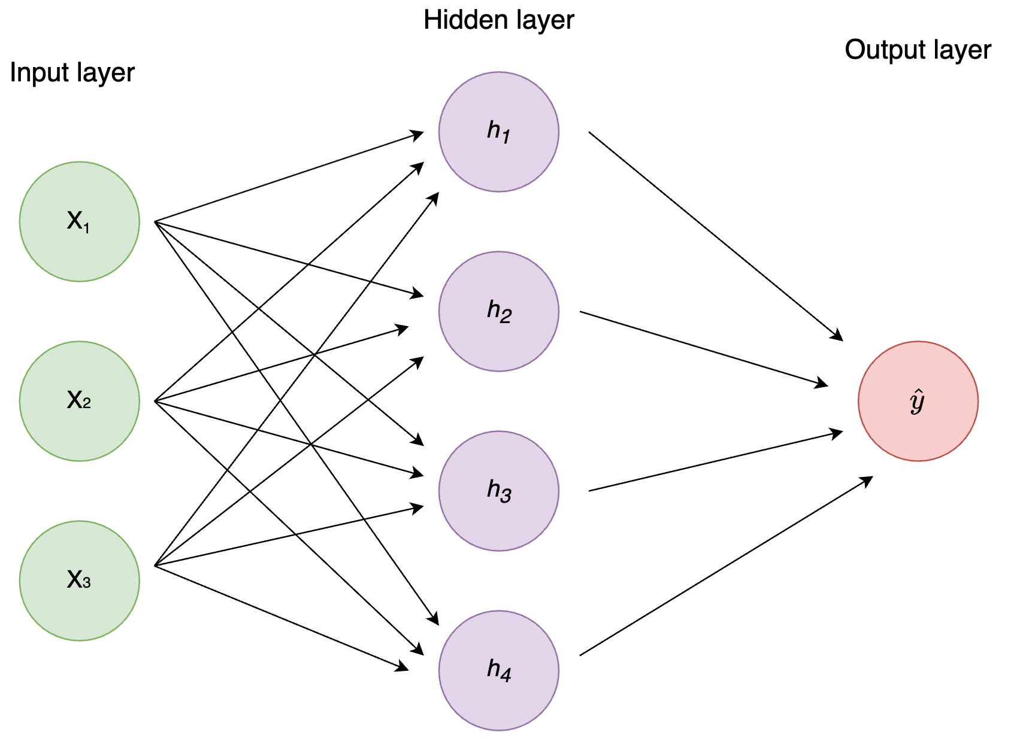
Hyperparameters - Examples
Mandatory
  Initial weights
  Learning rate
  Stopping condition
Network architecture (covered in 2 lectures)
  Depth of the network (how many layers)
  Thickness of the network (how many neurons in parallel per layer)
Data related (next lecture)
  Augmentations
Loss function bias
  Batch norming
  Dropout
  Regularization
  Many, many more
Notes:
Batch norm -> scale down the inputs so that each layer receives an input around same order of magnitude
Used in transformers (LLMs)
Dropout: Hold some neurons constant at each step s.t. the trend must be learned in part by the whole network -> can’t rely on few neurons to do the heavy lifting

Slide 20
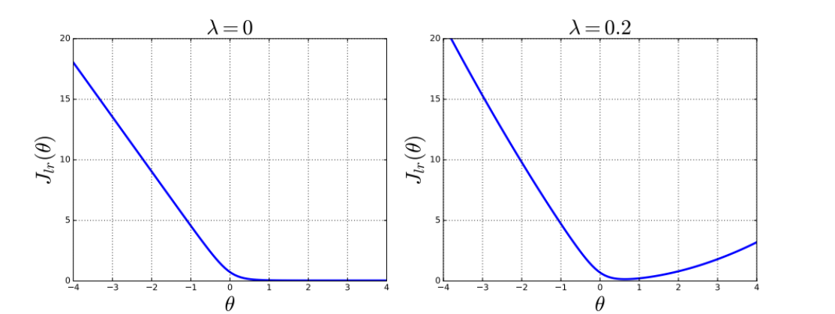
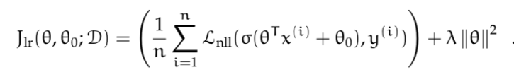
Regularization
Notes:
Not critical more of an FYI slide
The bigger our weights (theta) get, the bigger the loss gets.
So our weights are biased toward zero, as can be seen in the 1d case above.
Can have other biases but this is standard.

Slide 21

Ridge Regression
Regression with a regularization term
Lasso the same but without the square (absolute)
  Tends to remove many parameters from the model
Notes:
That might be what you want if you think the result is sparse

Slide 22
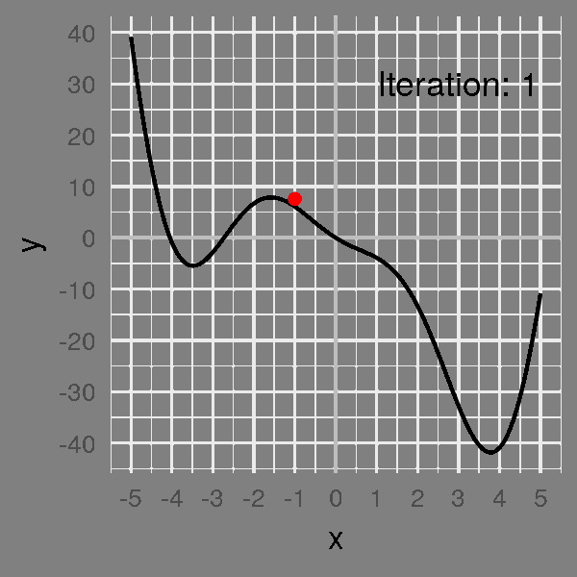

Gradient Descent - Revisit
Algorithm:
Find gradient at start point
Move opposite that direction by an amount = gradient magnitude times a constant (learning rate)
Repeat until the value between steps changes less than a set amount (or a fixed number of times)
Notes:
Revisiting now to see something crucial about AI algorithms – We’re approximating
See how at the bottom of the hill we come to the end but don’t really find the bottom

Slide 23
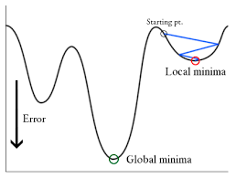
Gradient Descent - Revisit

Slide 24
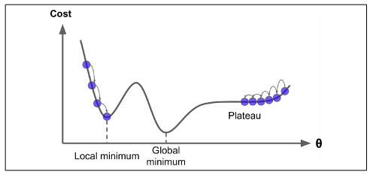
Gradient Descent - Revisit
Notes:
Also possible to just skip over the global minimum entirely

Slide 25
Gradient Descent - Revisit
Takeaway: All AI algorithms are, by definition, approximations
Lots of work is happening under the hood to help us find the global min/max
Often worth retraining networks with different parameters if result isn’t good
Choice of hyperparameters can greatly affect your loss
Notes:
Need to use intuition and understanding of the problem to select these – not feasible to try them all.
Approximations mean AI currently better for creativity than closed form problem solving

Slide 26
Stochastic GD
Avoiding pitfalls in GD via introducing random element
Instead of descending down gradient of all points together, choose 1 point and make weights better for just that point
On average, processes like the normal way would

Slide 27
Vanishing Gradient Problem
Over many layers, gradient can either blow up (if values large) or vanish (if values close to 0)
Many things under the hood happening to prevent this
  Batch norm
  Choice of activation (ReLU safer than Sigmoid, Tanh)

Slide 28
Ensembling
Methods for training multiple models on same data, then averaging or combining in smart way to get better performance
Bootstrapping: Training many models and averaging their results
  Build datasets by sampling w replacement, then train
  Often used in cases with little data
Boosting:
  Train model, then train new model whose goal is to take output of first one and reduce its loss when applied to data
Random Forest
  To be discussed later

Slide 29
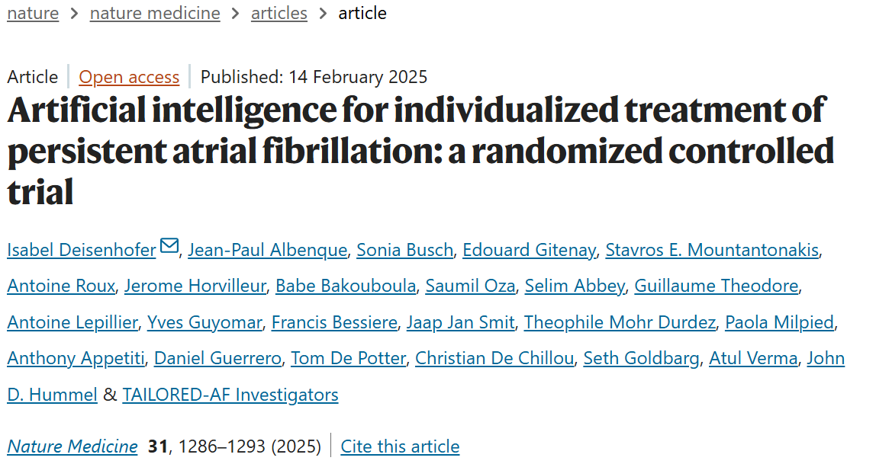
Case Study

Slide 30
General Problem Statement
Measure afib recurrence in 2 groups, one informed by AI, one not
Technical Problem Statement
RCT comparing humans to classification model, which predicts regions which should be ablated
Data | Loss
Proprietary dataset of 275k (train) and 113k (test) mappings Annotations by EP doctors in France/USA | Not listed – assume creative combo of cross entropy with DICE or other 3d loss d/t problem construction (classification+CNN) Study aim: Compare inter observer variability to network/observer
Network | Training
Multimodal network integrating Classifier Convolutional network | Single train/test split Extreme gradient boosting (ensembling)

Slide 31
RCT Design
370 patients underwent catheter ablation
Divided randomly into 2 groups: 1 with AI assistance during procedure, 1 without
  Assistance is highlighted locations which might represent “dispersion” or sites from which electrical waves originate
  Essentially sites of dispersion become ablation targets

Slide 32
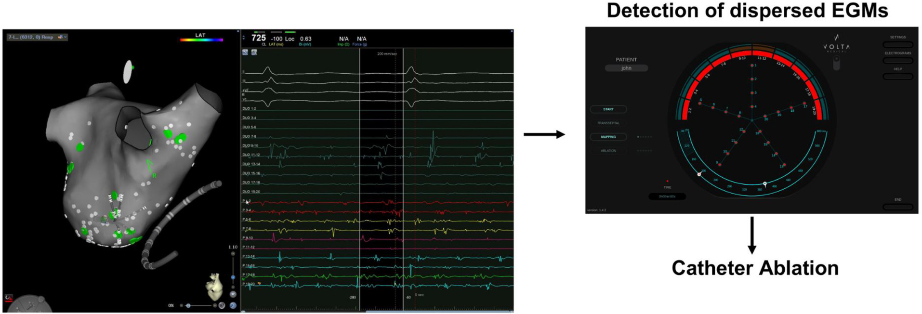
Algorithm Results
AUROC = .93 -> better when experts all agreed on location of dispersion or lack thereof

Slide 33
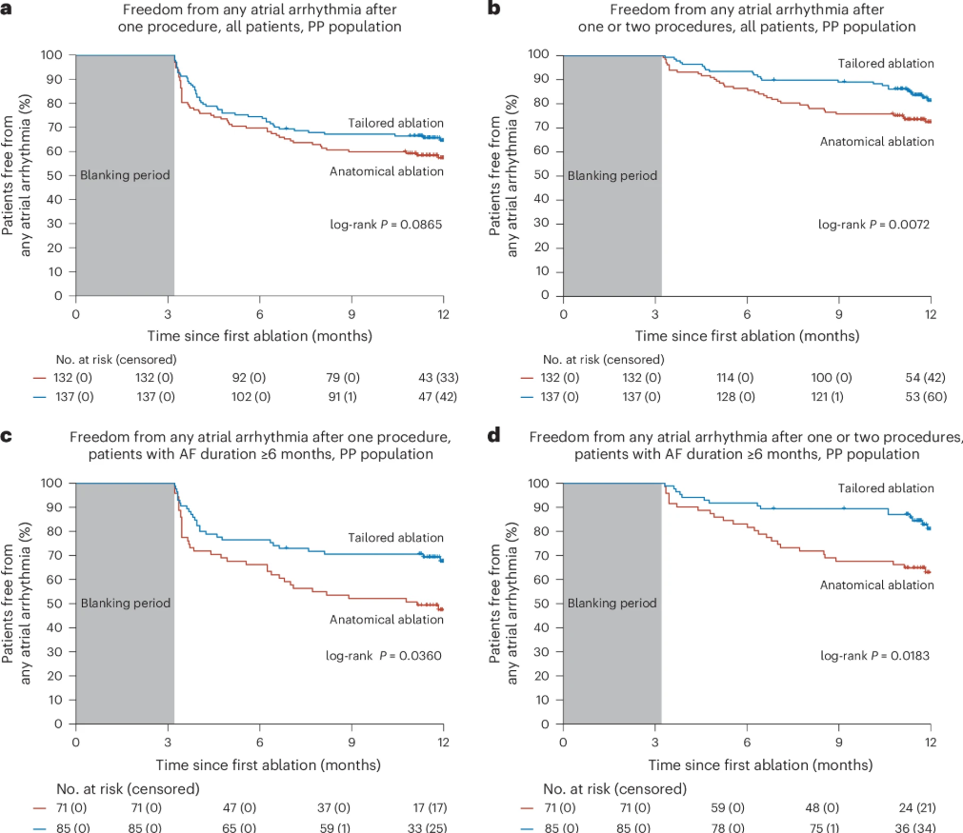
Notes:
Top left: freedom in general after 1 procedure. Top right: after 1 or 2
Bottom L: AF>6months, one procedure
Significant after multiple procedures or with sustained AF

Slide 34
Takeaways
Authors have clear conflict of interest
With that said, results were significant in 2 ablation, and sustained Afib groups
  Of course, be skeptical of subgrouping
Noted qualitative increase in complication rate in AI assisted group
As algorithms improve could be a useful tool
Notes:
Who knows what other subgroups were not chosen

Slide 35
Recipe for Training
Problem formulation
Mapping between inputs and outputs
Choose loss function (often informed by problem formulation)
Train/test split
Train according to loss
Repeat training and average across many runs
Adjust hyperparameters as needed and repeat
Notes:
What is your problem? How will you solve it? Classification vs regression vs other
Split can be binary, or into k folds
For those interested there’s a good link in the folder with much more detail

